Slide 1
UPPER SIXTH ARTS
GEOGRAPHY
Lesson 4
Climatic Change
Notes:
Good morning, class, and welcome to our geography lesson. I am your geography teacher, Mr Kamdem. Today we are starting Lesson 4: Climatic Change.

Slide 2
CLASS INFO
Class, Chapter and Duration
Class | Upper Sixth Arts
Chapter | Module 7: Understanding and managing contemporary environmental and development issues
Duration | 2 periods (2 × 50 minutes)
Notes:
This lesson is for Upper Sixth Arts. It belongs to Module 7: Understanding and managing contemporary environmental and development issues. We shall need 2 periods to cover it.

Slide 3
IDENTIFICATION
Lesson Identification
Topic | Contemporary Environmental Issues
Sub-topic | Climate Change
Lesson | Lesson 4: Climatic Change
Notions / Concepts | Climate change, greenhouse gases, ice core, El Niño, Milankovitch cycles.
Syllabus focus | Meaning; evidence; natural and human causes.
Competence | Learners are able to explain the evidence and causes of climate change.
Notes:
Our topic is Contemporary Environmental Issues, and the sub-topic is Climate Change. The key notions we shall use today are: climate change, greenhouse gases, ice core, El Niño, Milankovitch cycles. At the end, you should be able to do this: learners are able to explain the evidence and causes of climate change.

Slide 4

HOMEWORK CORRECTION
Correction of the Homework
Question (Lesson 3: Soil Erosion):
Observe a slope near your home and suggest two ways to protect its soil.
Notes:
Before we start the new lesson, let us correct the homework I gave you at the end of Lesson 3: Soil Erosion. The question was: Observe a slope near your home and suggest two ways to protect its soil. Take out your exercise books.

Slide 5
HOMEWORK CORRECTION
Correction: Possible Answer
Examples: plant grass or trees on the slope; build stone lines or terraces across it; plough along the contours; mulch the bare soil.
Notes:
Here is a good answer. Examples: plant grass or trees on the slope; build stone lines or terraces across it; plough along the contours; mulch the bare soil. Compare it with your own answer and correct your work in red.

Slide 6
LESSON PLAN
Lesson Plan
Correction of the homework
Objectives and recall
Real-life situation and action to take
Learning activities
Board summary
Evaluation, remediation and homework
Notes:
Here is the plan of our lesson today. First, we shall correct the homework. Then we shall look at the objectives and recall what you already know. After that, we shall study a situation from real life and the action to take, and do the learning activities. Finally, we shall copy the board summary, do the evaluation and the remediation, and I will give you the homework.

Slide 7
OBJECTIVES
Objectives
By the end of this lesson, you should be able to:
Define climatic change.
Describe the evidence of climate change.
Explain its natural and human causes.
Notes:
By the end of this lesson, you should be able to do three things. Number 1: define climatic change. Number 2: describe the evidence of climate change. Number 3: explain its natural and human causes.

Slide 8
PREVIOUS KNOWLEDGE
Previous Knowledge
Climate is the average weather over a long time.
Burning fuels releases carbon dioxide.
Notes:
Let us first remember what you already know. Climate is the average weather over a long time. Burning fuels releases carbon dioxide. Keep this in mind, because we shall build on it today.

Slide 9
REAL-LIFE SITUATION
Situation in Real Life
Old farmers in the North say the rains now start later and stop earlier than when they were young. Scientists also show that glaciers are melting on mountains around the world.
Notes:
Listen carefully to this situation from real life. Old farmers in the North say the rains now start later and stop earlier than when they were young. Scientists also show that glaciers are melting on mountains around the world. Think about it, because I am going to ask you some questions.

Slide 10
REAL-LIFE SITUATION
Situation: Question 1
What is the problem in the situation?
Notes:
Question 1: What is the problem in the situation? Think for a moment, then raise your hand to answer.

Slide 11
REAL-LIFE SITUATION
Answer
The climate is changing.
Notes:
Good. The climate is changing.

Slide 12
REAL-LIFE SITUATION
Situation: Question 2
Give one piece of evidence in the situation.
Notes:
Question 2: Give one piece of evidence in the situation. Think for a moment, then raise your hand to answer.

Slide 13
REAL-LIFE SITUATION
Answer
Melting glaciers (or changing rains).
Notes:
Good. Melting glaciers (or changing rains).

Slide 14
REAL-LIFE SITUATION
Situation: Question 3
Is climate change natural or human?
Notes:
Question 3: Is climate change natural or human? Think for a moment, then raise your hand to answer.

Slide 15
REAL-LIFE SITUATION
Possible Answer
Both, but today it is mainly caused by people.
Notes:
Good. Both, but today it is mainly caused by people.

Slide 16
ACTION TO TAKE
Action to Take
Reduce greenhouse gas emissions in daily life.
Notes:
From this situation, the action we are working towards in this lesson is the following: reduce greenhouse gas emissions in daily life.

Slide 17
JUSTIFICATION
Justification of the Lesson
This lesson helps us to understand the changes in our climate.
Notes:
Why is this lesson important for you? This lesson helps us to understand the changes in our climate.

Slide 18
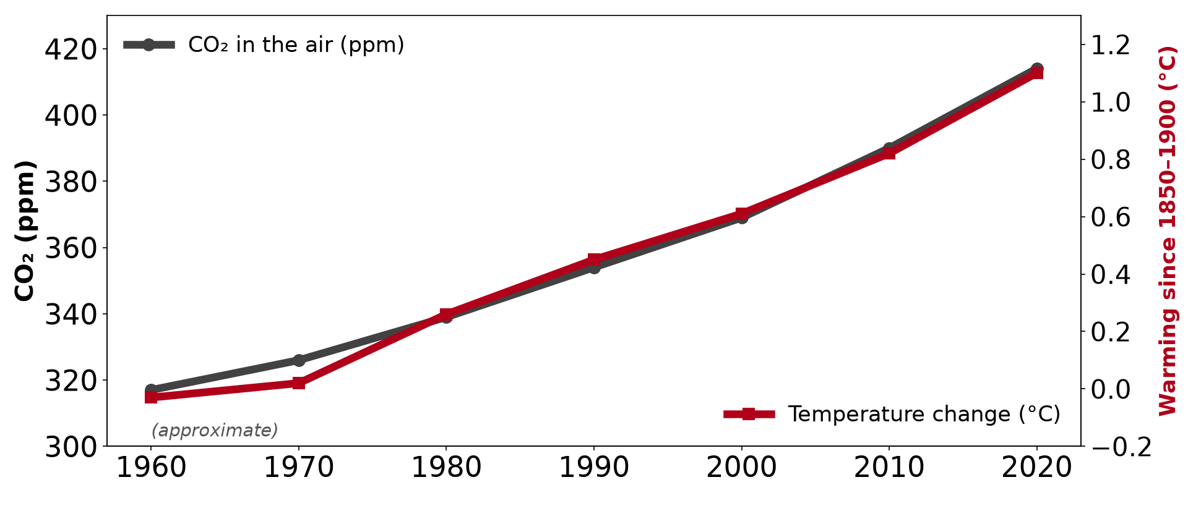
1. MEANING OF CLIMATIC CHANGE
Activity 1
CO₂ and world temperature (approximate).
Notes:
Activity 1. Look carefully at this diagram: cO₂ and world temperature (approximate). Observe every detail before I ask the question.

Slide 19
1. MEANING OF CLIMATIC CHANGE
Activity 1: Question
What happened to CO₂ and temperature since 1960?
Notes:
Here is the question for Activity 1: What happened to CO₂ and temperature since 1960? Take one minute to think and write your answer in your rough notebook.

Slide 20
1. MEANING OF CLIMATIC CHANGE
Activity 1: Answer
Both rose steadily: CO₂ from about 317 to 414 ppm and temperature by about 1 °C.
Notes:
Let us check the answer together. Both rose steadily: CO₂ from about 317 to 414 ppm and temperature by about 1 °C.

Slide 21
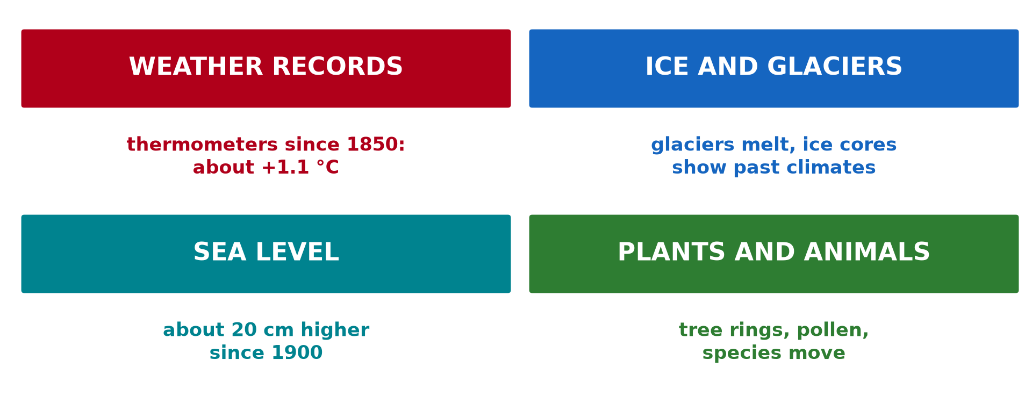
2. EVIDENCE
Activity 2
Evidence of climate change.
Notes:
Activity 2. Look carefully at this diagram: evidence of climate change. Observe every detail before I ask the question.

Slide 22
2. EVIDENCE
Activity 2: Question
Give three pieces of evidence of climate change.
Notes:
Here is the question for Activity 2: Give three pieces of evidence of climate change. Take one minute to think and write your answer in your rough notebook.

Slide 23
2. EVIDENCE
Activity 2: Answer
Weather records, melting glaciers and rising sea level.
Notes:
Let us check the answer together. Weather records, melting glaciers and rising sea level.

Slide 24
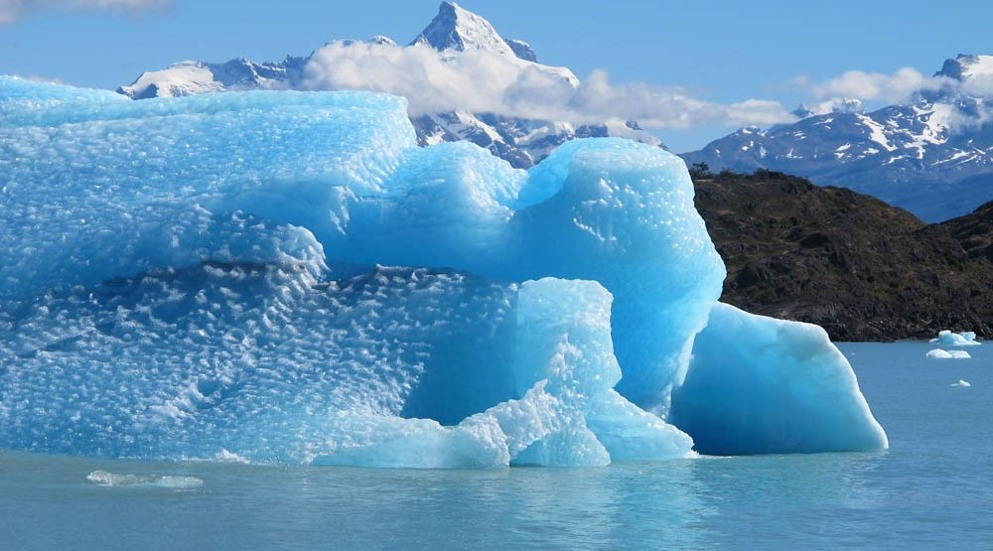
2. EVIDENCE
Activity 3
Melting ice.
Notes:
Activity 3. Look carefully at this picture: melting ice. Observe every detail before I ask the question.

Slide 25
2. EVIDENCE
Activity 3: Question
How does melting ice show climate change?
Notes:
Here is the question for Activity 3: How does melting ice show climate change? Take one minute to think and write your answer in your rough notebook.

Slide 26
2. EVIDENCE
Activity 3: Answer
Ice melts because the air and sea are warmer.
Notes:
Let us check the answer together. Ice melts because the air and sea are warmer.

Slide 27
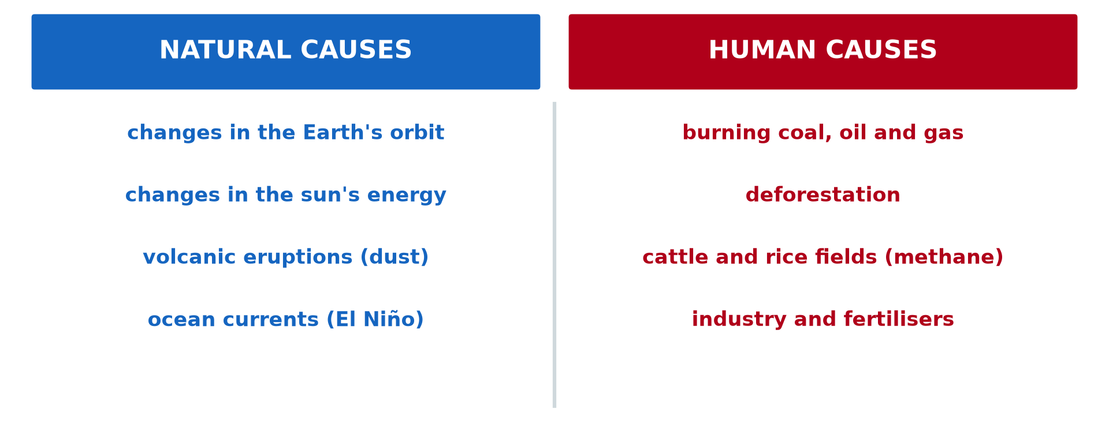
3. NATURAL CAUSES
Activity 4
Natural and human causes.
Notes:
Activity 4. Look carefully at this diagram: natural and human causes. Observe every detail before I ask the question.

Slide 28
3. NATURAL CAUSES
Activity 4: Question
Give two natural causes of climate change.
Notes:
Here is the question for Activity 4: Give two natural causes of climate change. Take one minute to think and write your answer in your rough notebook.

Slide 29
3. NATURAL CAUSES
Activity 4: Answer
Changes in the Earth's orbit and volcanic eruptions (also the sun and El Niño).
Notes:
Let us check the answer together. Changes in the Earth's orbit and volcanic eruptions (also the sun and El Niño).

Slide 30
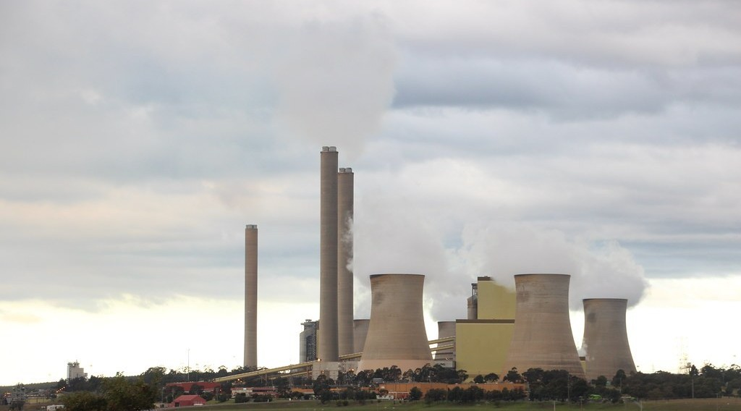
3. HUMAN CAUSES
Activity 5
A coal power station.
Notes:
Activity 5. Look carefully at this picture: a coal power station. Observe every detail before I ask the question.

Slide 31
3. HUMAN CAUSES
Activity 5: Question
How do power stations change the climate?
Notes:
Here is the question for Activity 5: How do power stations change the climate? Take one minute to think and write your answer in your rough notebook.

Slide 32
3. HUMAN CAUSES
Activity 5: Answer
Burning coal releases CO₂, a greenhouse gas that traps heat.
Notes:
Let us check the answer together. Burning coal releases CO₂, a greenhouse gas that traps heat.

Slide 33
BOARD SUMMARY
Board Summary
Topic: Contemporary Environmental Issues
Sub-topic: Climate Change
Lesson 4: Climatic Change
Notes:
Now we are going to copy the board summary. Write the title and the headings neatly in your notebooks. I will give you enough time for each slide, so do not rush.

Slide 34
BOARD SUMMARY
1. Meaning of Climatic Change
Climatic change can be defined as follows:
Climatic change: It is a long-term change in the average climate of a place or of the world. It concerns temperature, rainfall and winds over decades or more.
Notes:
Let us copy Meaning of Climatic Change. Climatic change can be defined as follows. On this slide we have Climatic change. Write each point on a new line, with the key term first, and explain it in your own words when we revise. When you finish, we go to the next slide.

Slide 35
BOARD SUMMARY
1. Meaning of Climatic Change (continued)
Greenhouse gases: They are gases such as carbon dioxide, methane and water vapour that trap heat in the atmosphere. Their amount has risen sharply since 1850.
Notes:
We continue with Meaning of Climatic Change. On this slide we have Greenhouse gases. Write each point on a new line, with the key term first, and explain it in your own words when we revise.

Slide 36
BOARD SUMMARY
1. Meaning of Climatic Change
Illustration: CO₂ and world temperature (approximate)
Notes:
Now draw this illustration in your notebook: cO₂ and world temperature (approximate). Give it a title and label it clearly.

Slide 37
BOARD SUMMARY
2. Evidence of Climatic Change
Climatic change is shown by the following evidence:
Instrumental records: Thermometer records show about 1.1 °C of warming since 1850. Rainfall patterns and the length of seasons are changing.
Notes:
Let us copy Evidence of Climatic Change. Climatic change is shown by the following evidence. On this slide we have Instrumental records. Write each point on a new line, with the key term first, and explain it in your own words when we revise. When you finish, we go to the next slide.

Slide 38
BOARD SUMMARY
2. Evidence of Climatic Change (continued)
Ice and sea evidence: Glaciers and polar ice are melting and the sea level is rising. Ice cores show past levels of carbon dioxide and temperature.
Notes:
We continue with Evidence of Climatic Change. On this slide we have Ice and sea evidence. Write each point on a new line, with the key term first, and explain it in your own words when we revise. When you finish, we go to the next slide.

Slide 39
BOARD SUMMARY
2. Evidence of Climatic Change (continued)
Biological and historical evidence: Tree rings, pollen and fossils show past climates. Old writings and paintings record past droughts, floods and cold periods.
Notes:
We continue with Evidence of Climatic Change. On this slide we have Biological and historical evidence. Write each point on a new line, with the key term first, and explain it in your own words when we revise.

Slide 40
BOARD SUMMARY
2. Evidence of Climatic Change
Illustration: evidence of climate change
Notes:
Now draw this illustration in your notebook: evidence of climate change. Give it a title and label it clearly.

Slide 41
BOARD SUMMARY
3. Causes of Climatic Change
Climatic change has natural and human causes:
Natural causes: Changes in the Earth's orbit (Milankovitch cycles) and in solar energy change climate over long periods. Volcanic dust and El Niño change it over shorter periods.
Notes:
Let us copy Causes of Climatic Change. Climatic change has natural and human causes. On this slide we have Natural causes. Write each point on a new line, with the key term first, and explain it in your own words when we revise. When you finish, we go to the next slide.

Slide 42
BOARD SUMMARY
3. Causes of Climatic Change (continued)
Human causes: Burning coal, oil and gas and cutting forests release carbon dioxide. Farming releases methane, which adds to the greenhouse effect.
Notes:
We continue with Causes of Climatic Change. On this slide we have Human causes. Write each point on a new line, with the key term first, and explain it in your own words when we revise.

Slide 43
BOARD SUMMARY
3. Causes of Climatic Change
Illustration: natural and human causes
Notes:
Now draw this illustration in your notebook: natural and human causes. Give it a title and label it clearly.

Slide 44
FORMATIVE EVALUATION
Evaluation 1
Give two pieces of evidence of climate change.
Notes:
Now let us check what you have understood. Question 1: Give two pieces of evidence of climate change. Answer in your exercise book.

Slide 45
FORMATIVE EVALUATION
Expected Answer
Rising temperatures and melting glaciers.
Notes:
The expected answer is: rising temperatures and melting glaciers. If you got it right, well done.

Slide 46
FORMATIVE EVALUATION
Evaluation 2
Give two natural and two human causes.
Notes:
Now let us check what you have understood. Question 2: Give two natural and two human causes. Answer in your exercise book.

Slide 47
FORMATIVE EVALUATION
Expected Answer
Natural: volcanoes, orbit changes. Human: burning fuels, deforestation.
Notes:
The expected answer is: natural: volcanoes, orbit changes. Human: burning fuels, deforestation. If you got it right, well done.

Slide 48
REMEDIATION
Remediation
Fill in the blanks:
CO₂ and methane are ______ gases.
Ice ______ show past climates.
Warming since 1850 is about ______ °C.
Notes:
For those who need more practice, fill in the blanks in your exercise book. The answers are: number 1, greenhouse; number 2, cores; number 3, number 1, 1.

Slide 49
HOMEWORK
Homework
Ask two elders how the seasons have changed and write their answers.
Notes:
For your homework: Ask two elders how the seasons have changed and write their answers. We shall correct it at the beginning of our next lesson.

Slide 50
NEXT LESSON
Next Lesson
Our next lesson will be on:
Lesson 5: Global Warming
Notes:
Our next lesson will be on Lesson 5: Global Warming. Thank you for your attention, and see you next time.

Slide 51
BILINGUAL GAME
Bilingual Game (Jeu Bilingue)
English | Français
Climate change | Le changement climatique
Evidence | La preuve
Glacier | Le glacier
Greenhouse gas | Le gaz à effet de serre
Volcano | Le volcan
Sea level | Le niveau de la mer
Notes:
Let us play the bilingual game. I say a word in English, and you give me the French word. Then we do the reverse.

Slide 52
LOGBOOK
Official Logbook (1/2)
Module / Topic | Contemporary Environmental Issues
Lesson Title | Lesson 4: Climatic Change
Expected Learning Outcomes | Define climatic change. Describe the evidence of climate change. Explain its natural and human causes.
Competence | Learners are able to explain the evidence and causes of climate change.
Notes:
I record this information in the official logbook of the class after the lesson.

Slide 53
LOGBOOK
Official Logbook (2/2)
Matter Taught | Meaning of Climatic Change; Evidence of Climatic Change; Causes of Climatic Change.
Evaluation | Formative evaluation and remediation exercise.
Homework | Ask two elders how the seasons have changed and write their answers.
Enrolment / Present / Absent | ____ / ____ / ____
Achievement | To be completed after the lesson.
Notes:
I complete the second page of the logbook: the matter taught, the evaluation, the homework and the attendance.

Slide 54
TEACHER'S NOTE
Teacher's Note
Timing: Homework correction, plan, objectives 8 min | Recall, situation, action 10 min | 5 activities 30 min | Board summary (copying) 30 min | Evaluation, remediation 10 min | Homework, next lesson 5 min | Logbook 7 min
Without the projector (Activity 1): read the graph.
Without the projector (Activity 2): list evidence.
Without the projector (Activity 3): discuss melting ice.
Without the projector (Activity 4): read the left column.
Without the projector (Activity 5): discuss fuels we burn.
Notes:
This slide is for me, the teacher: it gives the timing of the lesson and what to do if the projector is not available.

Slide 55
REFERENCES
References
National Geography Syllabus, MINESEC/IGE/IP-SS, 2019 — Module 7 (Environment and Development).
Photo, Activity 3: “Glaciers and Sea Level Rise” by NASA Goddard Photo and Video, CC BY 2.0, via nasa (https://www.flickr.com/photos/24662369@N07/8742463970)
Photo, Activity 5: “Loy Yang coal power station” by John Englart (Takver), CC BY-SA 2.0, via Flickr (https://www.flickr.com/photos/81043308@N00/18269071871)
Diagrams and animations: drawn for this lesson (Geography Department).
Notes:
These are the references and picture credits used to prepare this lesson.

